Slide 1

Intel’s next gen半導體工藝
組員：林偉翔01257174、許能翔01257176

Slide 2
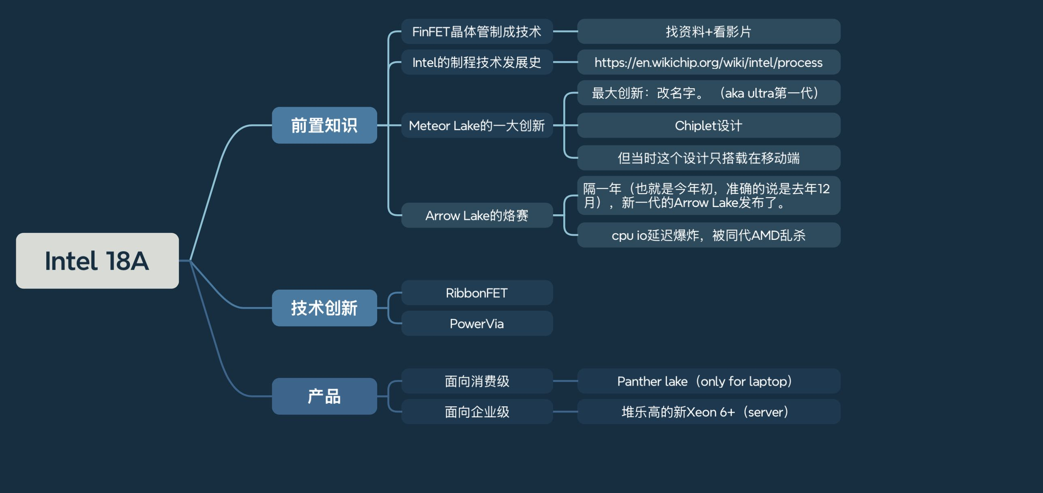

Slide 3


Slide 4
背面供電
PowerVia

Slide 5
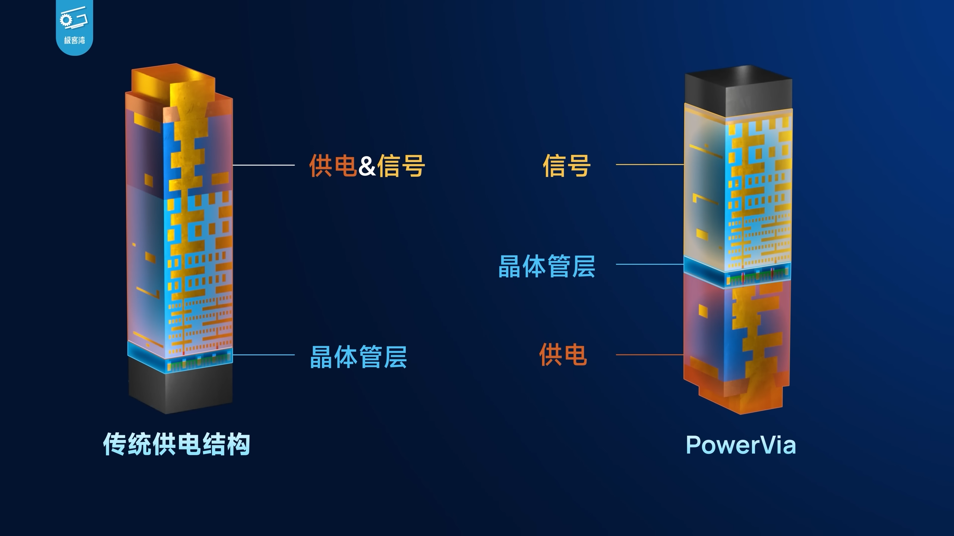

Slide 6
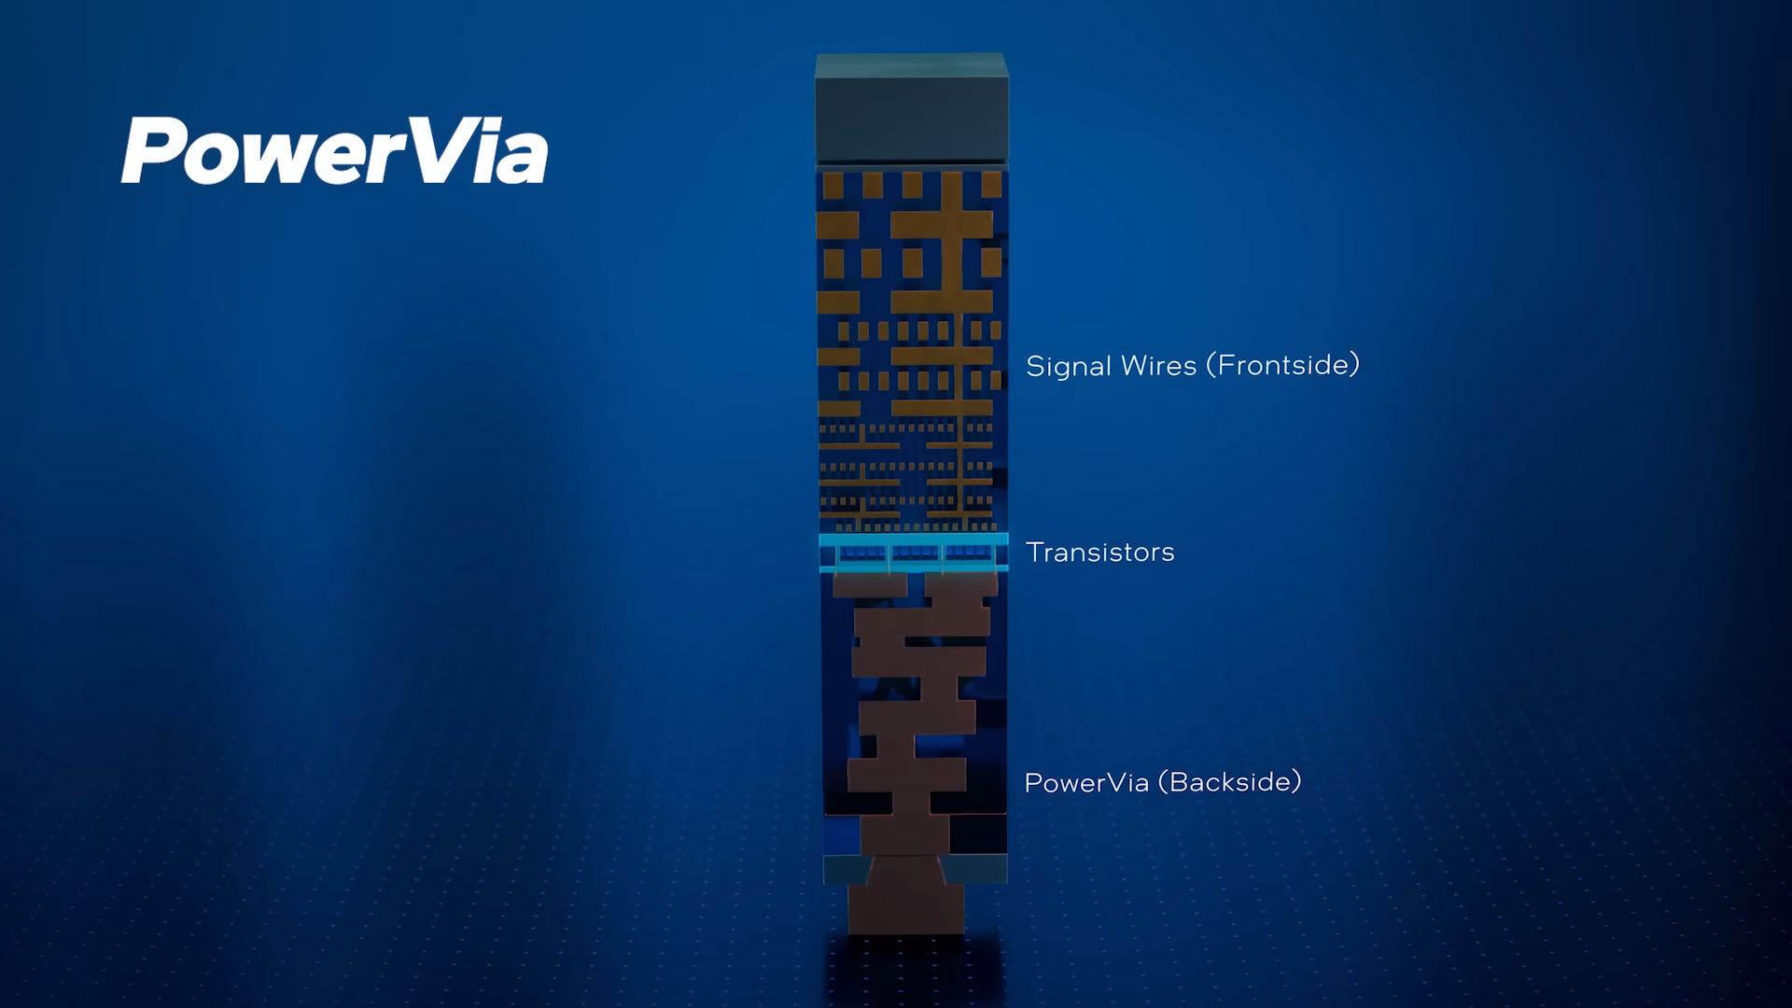

Slide 7


Slide 8
X3D by intel
Foveros 3D

Slide 9
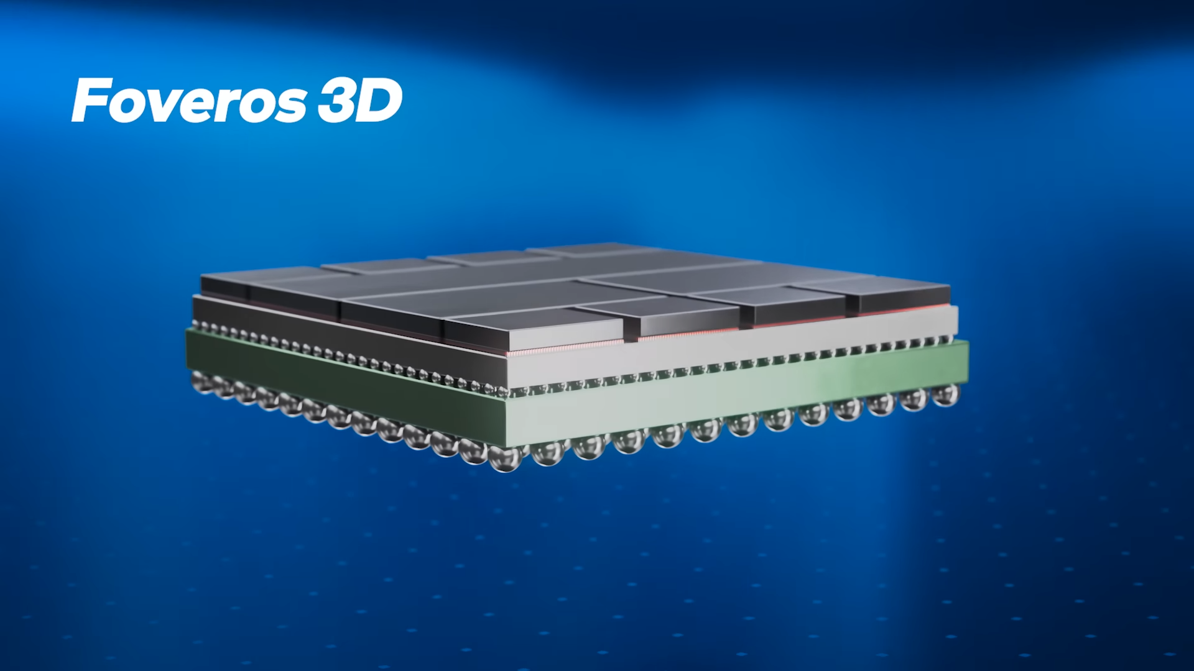

Slide 10
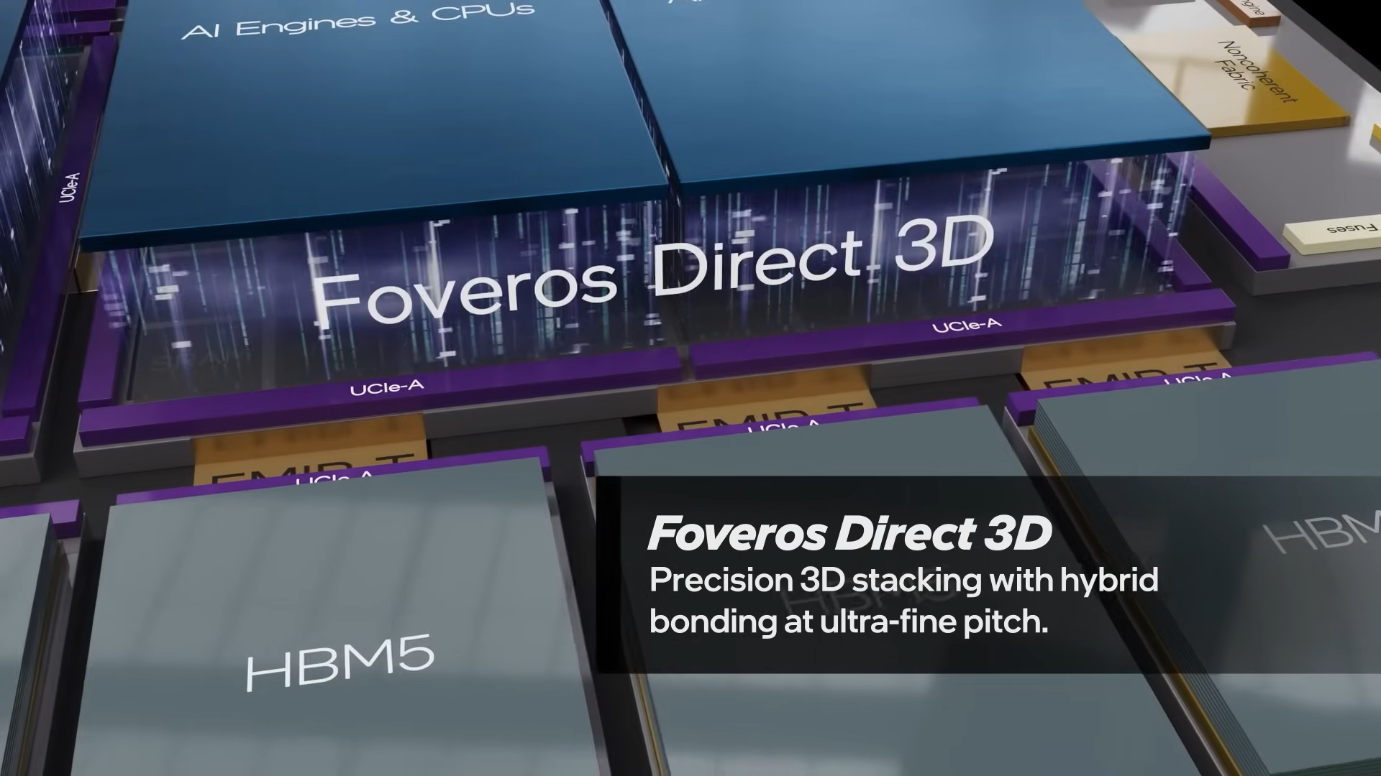

Slide 11
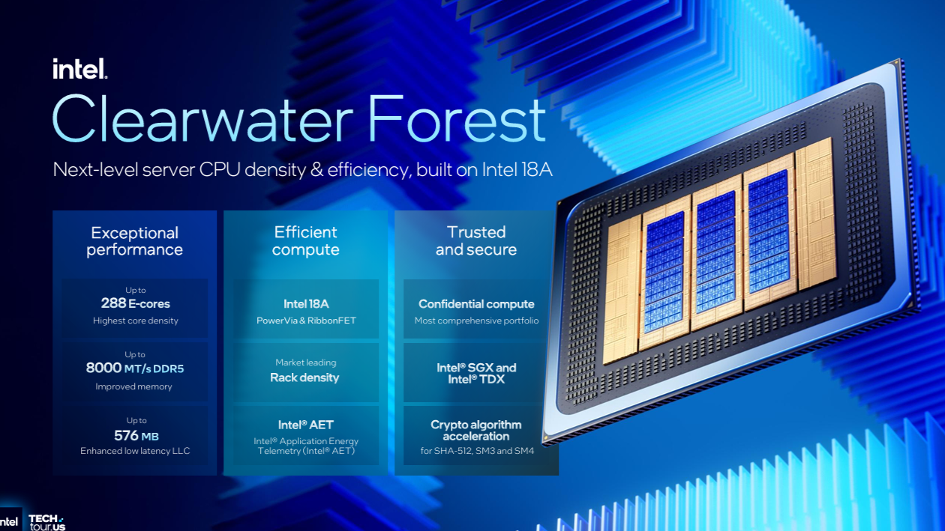

Slide 12
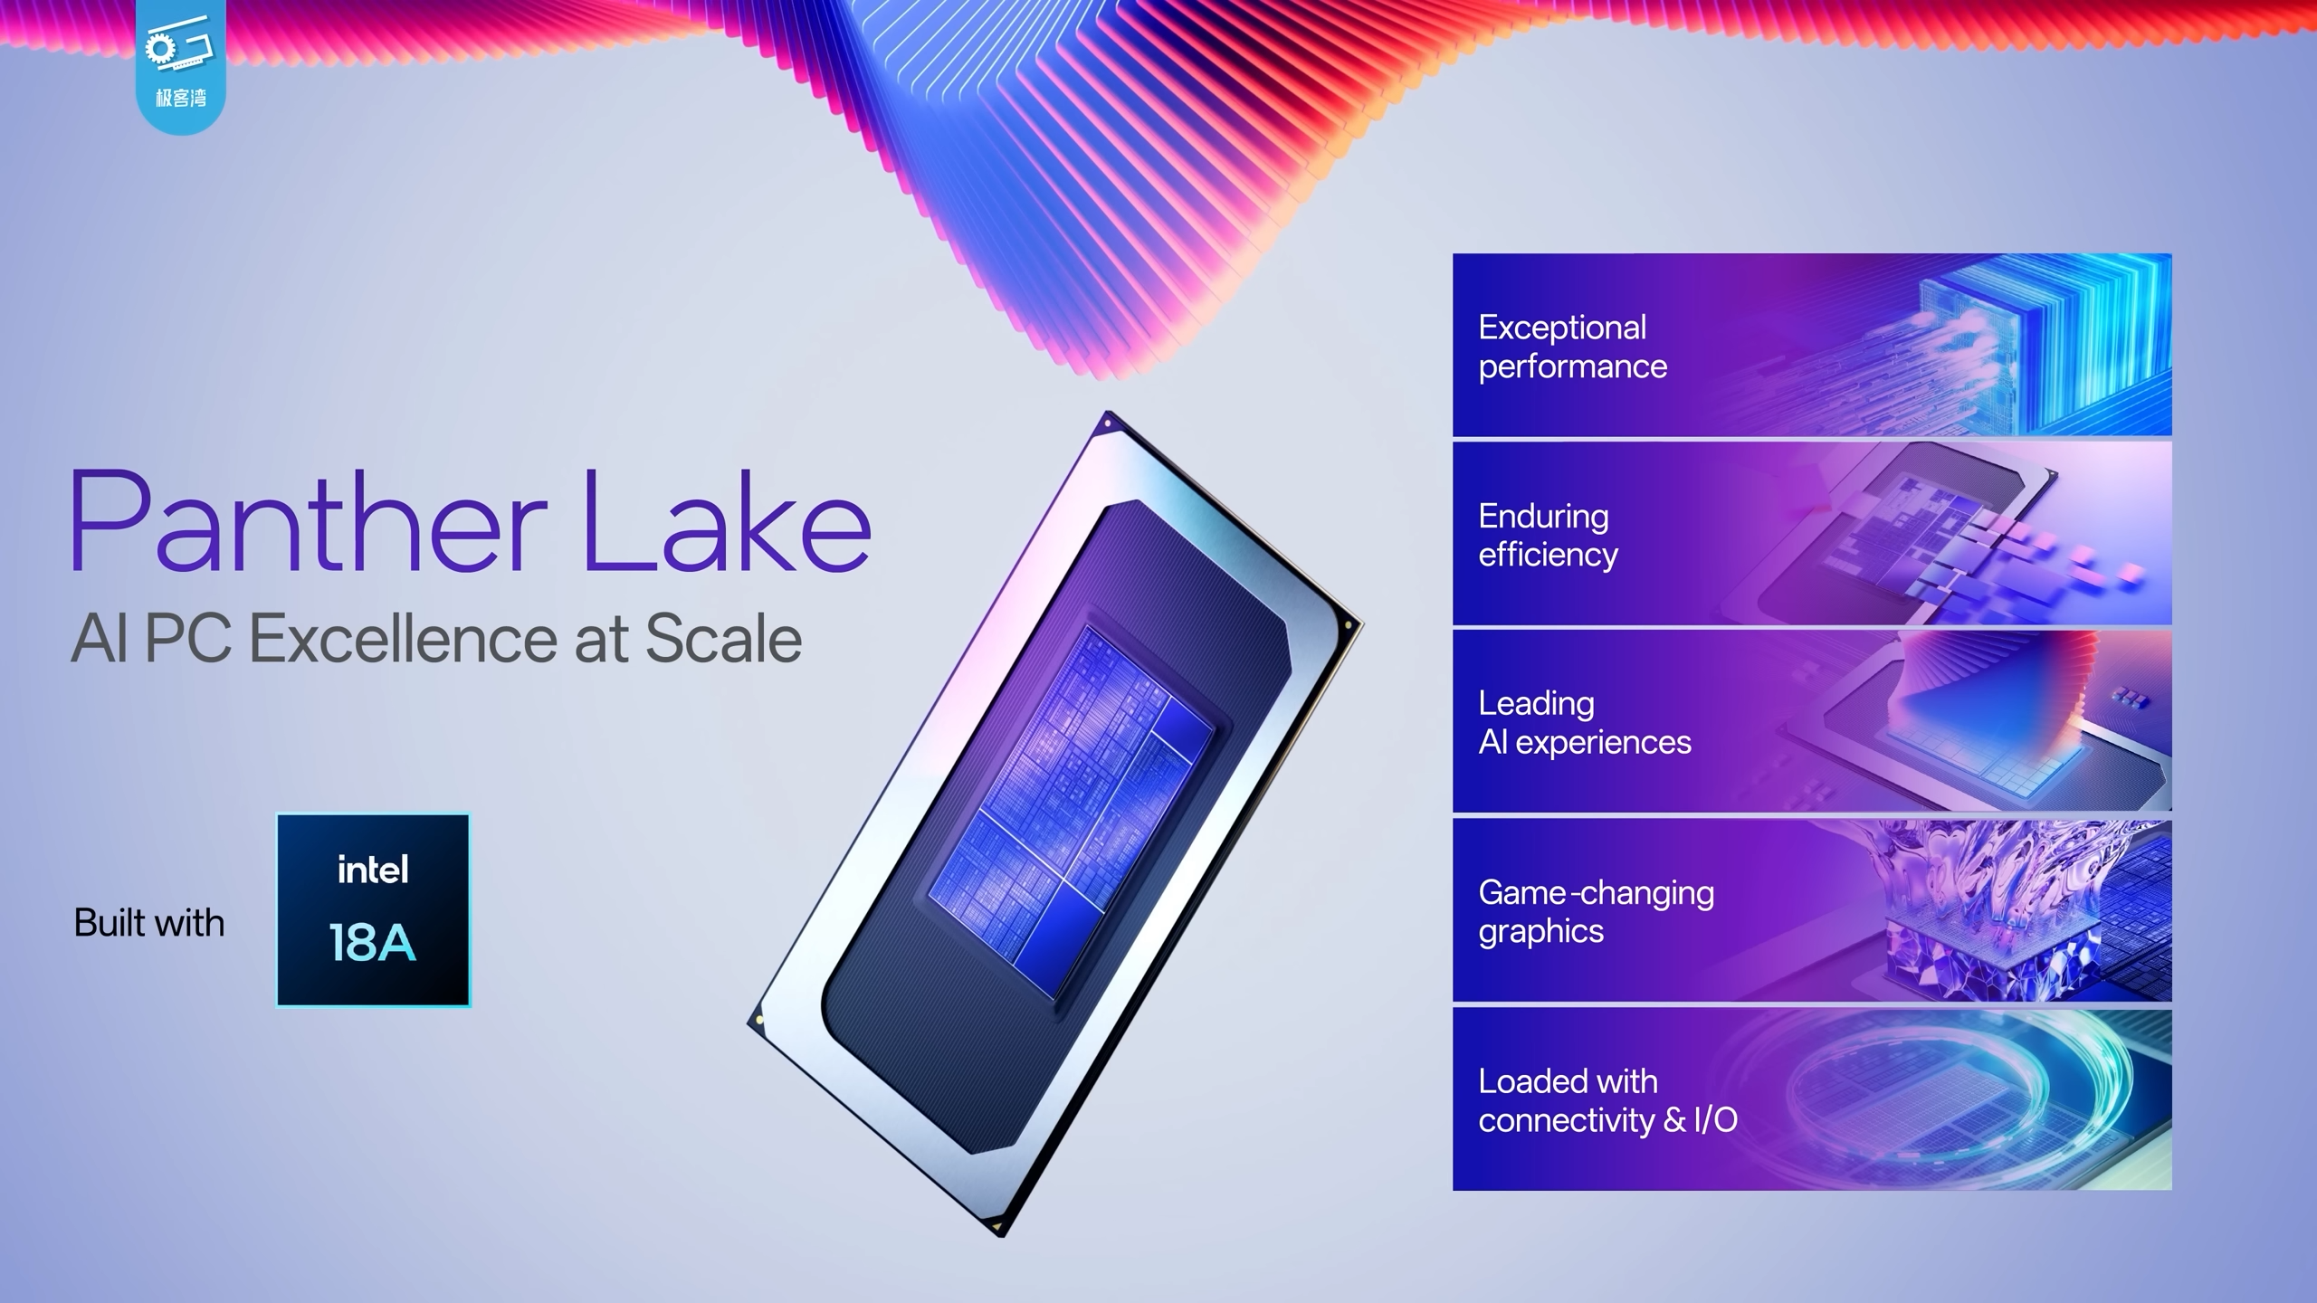

Slide 13
